Slide 1

CAIRN CONGREGATION PROJECT ROADMAP
BY: DANIEL DECARLO

Slide 2
Goal of Cairn Congregation:
Vision: Have an interactive platform for alumni and students that will create an opportunity for fellowship.
Opportunities: Cairn Congregation allows….
Students and Alumni to connect with each other.
Keep Students/Alumni up to date with events.
Create community in an online environment.
Students/Alumni to give back to the university.
Goals:
Create a platform for people to signup and find fellow users.
Create a way to fellowship with one another.
Check in with Cairn alumni and students.

Slide 3


Cairn Congregation Project Summary:
Languages Used: HTML 5, PHP, CSS, Bootstrap Library.
Deployed on Remote Desktop: csinfo.cairn.edu/~dd288/
Features:
Sign up
Profile/Edit
Search
Donate

Slide 4
What Worked Well?
Signing up has worked successfully and different users can create a profile to join the Cairn Community.
Users are able to access their profile data and can update their information.
Viewing and searching other peoples profile information.
Stable deployment and use.

Slide 5
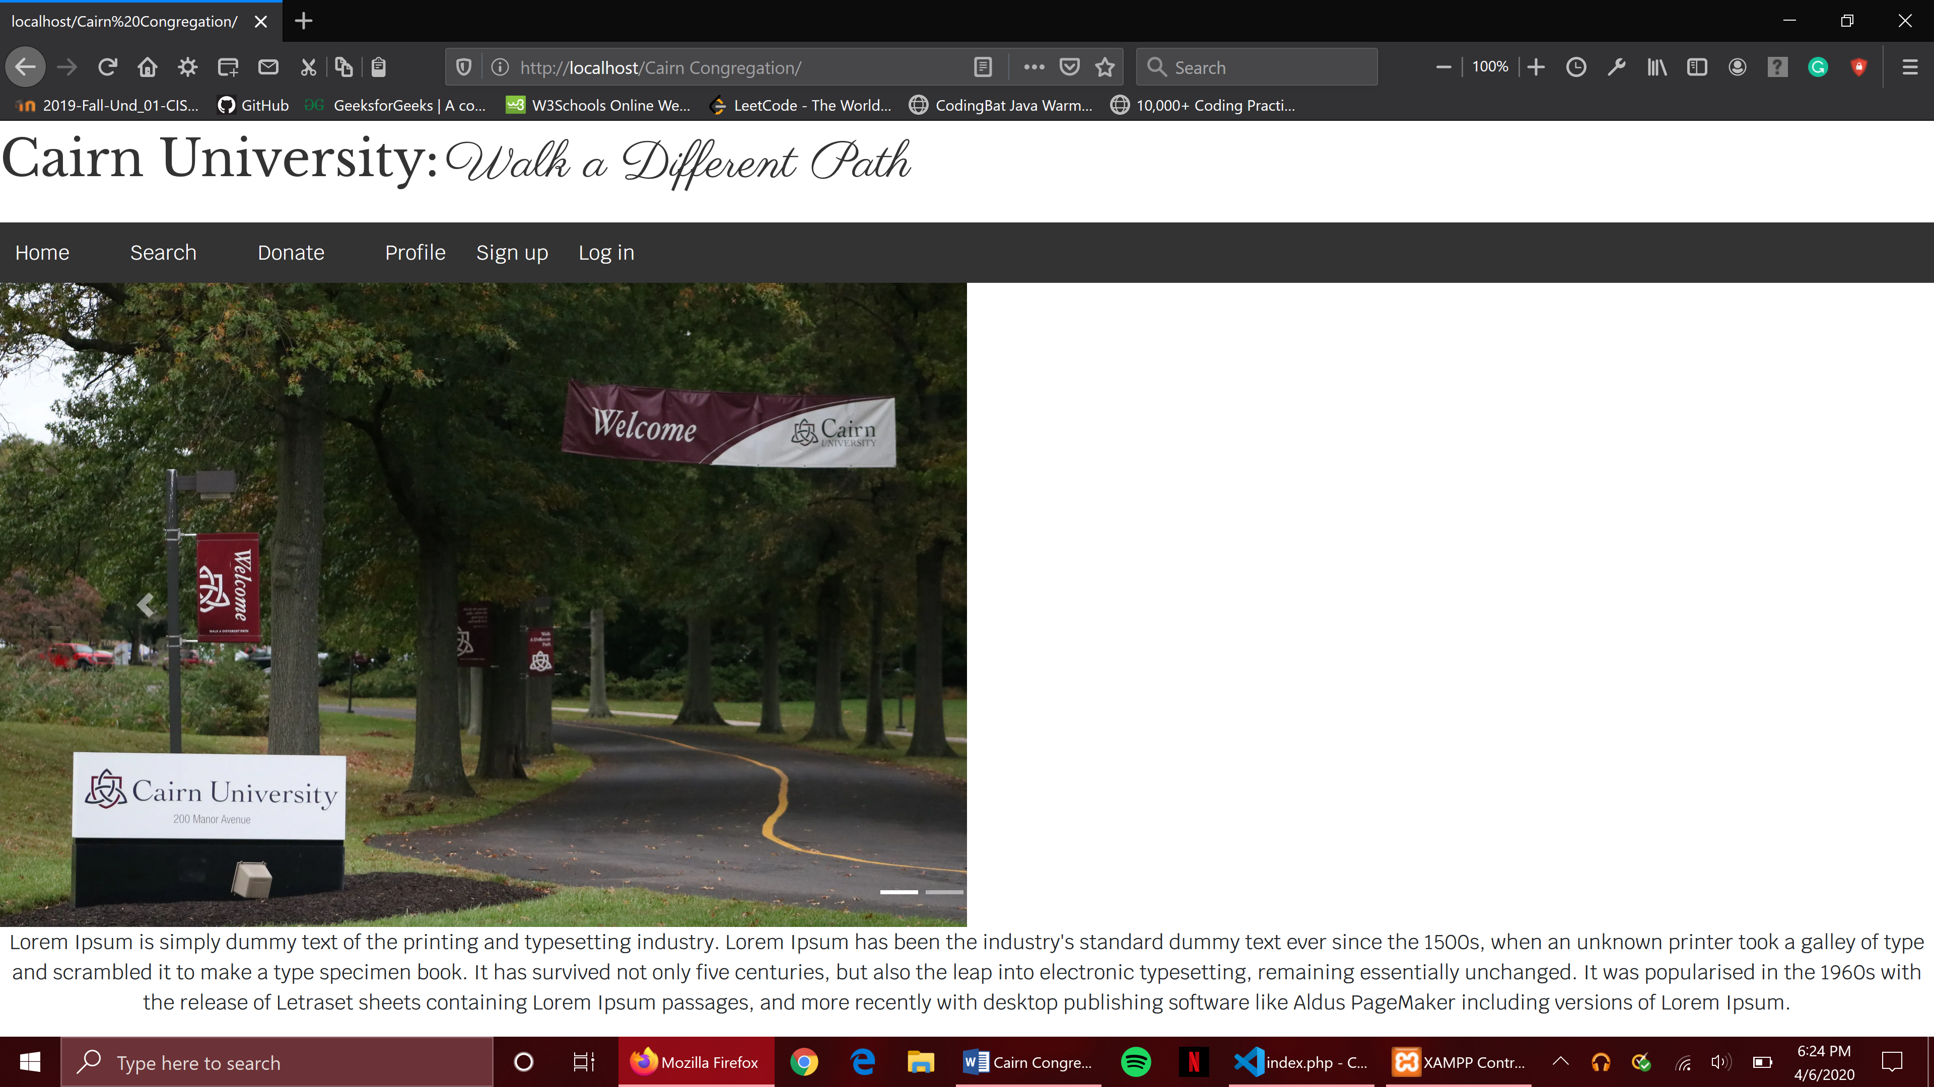
What Needs To Be Improved?
Short Term:
Better Design.
Better User Experience.
More features that can improve the community aspect.
Deploy on a platform more accessible to other users.
Long Term:
Better security for user’s information.
Ability to handle large amounts of data.
Easy access.
Ability to function in different environments .

Slide 6
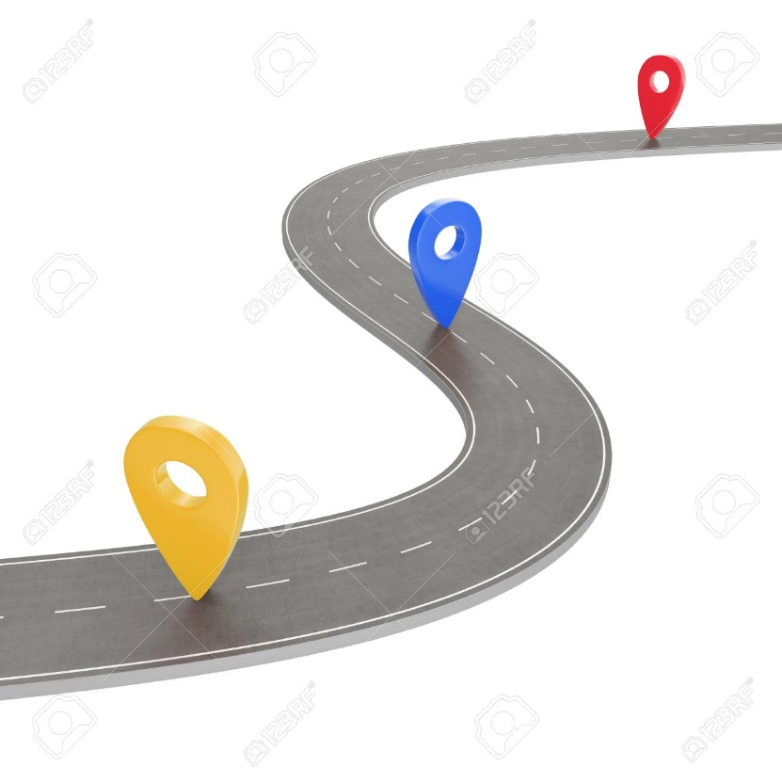
Where Would You Like The Project To Go?
Cairn Congregation is only accessible to certain individuals who can access the remote desktop connection. Cairn University would like more students and alumni to have access to the new platform. With other social media software like Facebook and Instagram Cairn Congregation will have a hard time competing with these platforms.
Cairn University would like to have similar features that make users enjoy Cairn Congregation and have a friendly experience like Facebook or Instagram.
Future Features:
Easier Admin Access
Alumni/Student Connections
More Profile Attributes
Delete Account and Data
Virtual Year Books
Accessibility:
Access to everyone
App

Slide 7
Project Roadmap
(Six month time frame)
Today
Q1 2020
Q2
Q1 2021
Q2
Q1 2022
Project Models/Quotes
Create documentation for new features
Documents
App Project Models/Project Quote
Create New Project Models For new design
Users Manual, deployment plan, Training
Users Manual, deployment plan, Training
Develop Features (Search, etc.)
Improve Design with updated models
Deploy for more access
App Development
Delivery &
Features
Deploy
Profile attributes/delete
Virtual Year Books
Create Admin Access/features
Risk Awareness
Access Control
Content Management
Risk Mgt
Risk Training
Security Testing/Updating
Testing &
Hypercare
Debugging/Maintenance
SIT/UAT
SIT/UAT
Debugging/Maintenance

